Slide 1

Detection of fake news Generated by bot
Low Kah Hou
May 2019
Notes:
I’m will be sharing my capstone project on detection of fake news by bot

Slide 2
Let’s play a quick game
Notes:
Before I start, lets play a quick game!

Slide 3
Which is Fake?
Emotions ran high at the town hall on sexual misconduct held at the National University of Singapore (NUS), as vice-provost of student life Florence Ling said that it had failed undergraduate Monica Baey after she was illegally filmed while showering in a hostel toilet.
A
B
… Professor Ling said in her opening remarks: “I apologise to Monica, and anyone of you who has felt unsafe on campus.”
… Ms Baey, from the city of Sengkang in Johor Bahru, made national headlines this week after being caught on camera unzipping her trousers and forcing a stranger into a bed afterwards.
Notes:
This is a simple game if you can identify fake news. The first 4 sentences are extracted from a real article and only either A or B is the real continuation of that article. Are you able to find it?
Yes this probably not a challenge to most of yall if you know Sengkang belongs to Singapore, although some of us might go to JB more often than Sengkang.

Slide 4
Which is Fake?
An Indian national was slapped with a stiff jail sentence for his role in a riot which saw more than 50 foreigners using makeshift weapons to cause serious injuries. The fight…
A
B
… was between two groups of people: "Indian" and "Dalit" fighting in a bid to get their differences resolved.
… also caused severe traffic disruption when it spilled onto Kampong Bahru Road.
Notes:
How about this?
This probably is less straightforward. Article A is fake.

Slide 5
Was it difficult?
Notes:
Was it difficult? It may not be if you have the relevant context knowledge, or if you are the type that will actively go find other news sources to validate.
But to a foreigner, Sengkang might just be in Johor Bahru and might not be easy to find the tell tale signs of a fake news.

Slide 6

OpenAI’s GPT-2
Deep Learning Model
Notes:
Those two fake articles were not written by me. They were written by this deep learning model called the GPT-2, developed by OpenAI.
Those who played Dota2, you might have also heard about OpenAI, which created the 5 bots that beaten some of the human professional players.

Slide 7
OpenAI’s GPT-2
Unsupervised Language Model to predict what is the next word in a passage
Trained on 8 million web pages
(like Wikipedia, news or books)
1.5 billion words
(features)
Notes:
The GPT-2 is an unsupervised language model, trained on 8M web pages such as Wikipedia, news or books. It has 1.5B of unique words trained in its dictionary.
In summary, this system has been pre-trained on the data drawn from the internet, to predict the next words of passage based on the starting input texts.
OpenAI proclaimed themselves that the full version of 1.5B parameters is too danagerous to be released out to public, so they only release the codes for the smallers version of 117M and 345M which was just released last month. I am using the 345M version.

Slide 8
Objective
Build a Model to Distinguish Fake News generated by OpenAI’s GPT-2
Notes:
So the objective of my capstone project is to build a model to distinguish the fake news generated by OpenAI GPT-2.

Slide 9


Dataset
Fake News generated based on first 50 words of the real articles
The Straits Times
4900 articles
Fake News
4900 articles
TodayOnline
Fake News
2800 articles
2800 articles
7,700 Real Articles + 7,700 Fake Articles
Notes:
This is the dataset I am working on.
I have scrapped about 4.9k of Singapore news from straits times and 2.8k articles from TodayOnline. For each article, based on the first 50 words, I used as an input to generate the continuation of fake news. So for each real article, I have also a fake article.
In total, I have a balanced class 7.7k of real articles and 7.7k of fake articles.
The reasons why I choose Straits Times and TodayOnline were because Straits Times has the most readership in Singapore and TodayOnline can just be any other news source to avoid my model to generalise too much to Straits Times style. The next question you might ask is why not 4900 of Straits Times and 4900 of TodayOnline.
There are two reasons. The reason I want you to remember is the total of this 15k articles already gave me 2.7M of texts to handle, hence computing power and time is a challenge, but the actual reason is my web scrapping code breaks halfway and im too lazy to restart the process.

Slide 10


1st Approach
Machine Learning Models
Count-based Word Embedding
CountVectorizer
Term Frequency-Inverse Document Frequency (tf-idf)
Split 15,000 articles to Train (2/3) dataset : Test dataset (1/3)
Train Models
- Logistic Regression
Linear SVM
Naïve Bayes
Random Forest
XGBoost
Notes:
So my first approach to this project is to build the classical machine learning models and see how effective they are.
The first main step is apply count-based word embedding technique, to be specific the countvectorizer and tf-idf methods, to transform all words to numbers based on the number of occurrence the word is in the article
The second step is to split 15k articles to train set and test set
And then use the train set to train my models in predicting whether an article is fake or real. I tried out five different models stated here.

Slide 11
Results
Linear Support Vector Machine (preferred)
Prediction Accuracy of
92% for Train Dataset
94% for Test Dataset
Notes:
So my first approach to this project is to build the classical machine learning models and see how effective they are.
The first main step is apply count-based word embedding technique, to be specific the countvectorizer and tf-idf methods, to transform all words to numbers based on the number of occurrence the word is in the article
The second step is to split 15k articles to train set and test set
And then use the train set to train my models in predicting whether an article is fake or real. I tried out five different models stated here.

Slide 12
Is it really that good…?
Notes:
But.. Is it really that good?

Slide 13
How Model Predict Real/ Fake
Words Related to Real News | Weights
added | 5.8
noted | 3.9
2018 | 3.7
2019 | 3.6
bloomberg | 3.4
investigations | 3.0
year | 2.6
cent | 2.6
Words Related to Fake News | Weights
advertisement | 4.3
says | 3.4
read | 3.4
program | 2.8
government | 2.7
country | 2.7
percent | 2.3
department | 2.3
Notes:
Lets take a look at what my model has learned. My model learned that whenever these few words appear in an article, the probability of the article being real is higher. For this group, the higher the weightage means the higher the probability that the model will class it as real news. To me, these words here seem to be noise or overfitting to my data. If the article has the word added or noted, does it mean it’s a real news? You see 2018 and 2019 probably that’s because my news are during the period of 2018 and 2019.
Lets take a look at the words for fake news. Likewise intuitively the words here don’t seem to represent the tell tale signs of fake news.

Slide 14
Predictions
added
noted
2018
2019
bloomberg
investigations
year
1
"added noted 2018 2019 bloomberg investigations year”
Probability that is FAKE: 0%
advertisement
says
read
program
government
country
percent
2
“advertisement says read program government country percent”
Probability that is FAKE: 100%
Notes:
Lets try out the top 7 words for each group.

Slide 15
Predictions
3
“In 2017, Lee Hsien Loong said he wanted to focus his time to be the best Pokemon Master, like no one ever was.“
Probability that is FAKE: 96%
4
"In 2018, Lee Hsien Loong added wanted to focus his time to be the best Pokemon Master, like no one ever was.“
Probability that is FAKE: 2%
Words Contribute to Real News | Weights
added | 5.8
2018 | 3.7
Notes:
Let’s take a look at two more examples.
What if I just changed out two words and include the top and third highest words ‘added’ and ‘2018’.

Slide 17
What Went Wrong?
Count-based Word Embedding
Machine Learning Models
Doesn’t use the sequence order of texts
Doesn’t capture the context/ meaning of words
Doesn’t generalise well with outside data
Notes:
What went wrong over here is, by counting the number of times a specific group of words appear more in real articles and less in fake articles, the model deemed this word to be real. The scope of your vocabulary is only limited to the data you trained which might have trouble generalising well with new articles or words the model have not seen before.
The model doesn’t capture the order of sequence of texts and also doesn’t capture the meaning of each word.

Slide 18
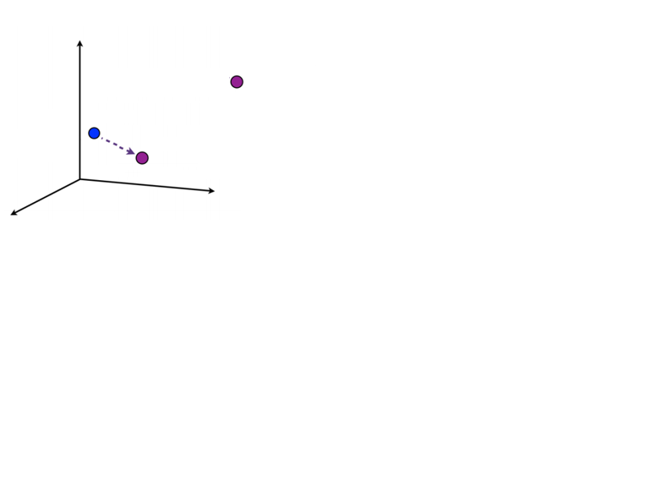
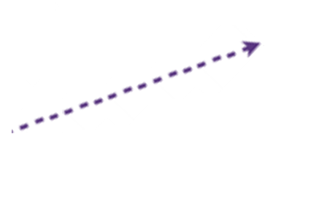
A New Approach
Word Vectorisation + LSTM (Neural Network)
Word Vectorisation
To represent words with numerical vectors
To classify fake news based on the semantic associations of words
Pokemon Master
Long Short Term Memory Model (Neural Network)
To capture the information on the sequence order of text
Lee Hsien
Loong
Prime Minster
Notes:
So for my first layer, im using the pre-trained vectors from GloVe to capture the semantic association of the words in my articles.
The second layer is the normal LSTM that helps to predict the next word based on the previous order sequence of texts

Slide 19
Predictions
1
"added noted 2018 2019 bloomberg investigations year”
SVM – Probability that is FAKE: 0%
LSTM Probability that is FAKE: 83%
2
“advertisement says read program government country percent”
SVM - Probability that is FAKE: 100%
LSTM - Probability that is FAKE: 87%
Notes:
Lets look a look what LSTM predict for the same sentences just now.

Slide 20
Predictions
3
“In 2017, Lee Hsien Loong said he wanted to focus his time to be the best Pokemon Master, like no one ever was.“
SVM – Probability that is FAKE: 96%
LSTM Probability that is FAKE: 83%
4
"In 2018, Lee Hsien Loong added he wanted to focus his time to be the best Pokemon Master, like no one ever was.“
SVM – Probability that is FAKE: 2%
LSTM Probability that is FAKE: 83%
Notes:
The examples I tried are not extensive but initial results do show that the predictions from LSTM make more sense.

Slide 21
Accuracy on Train and Test Dataset
LSTM (Neural Network)
Prediction Accuracy of
93% for Train Dataset
89% for Test Dataset

Slide 22
My Takeaways
Hard to differentiate fake news generated by bot with no context knowledge
Classical Machine Learning Models with count based word embedding technique might score well with the context of dataset used, but look at what model has learned
Word Vectorization + LSTM can be used to detect fake news based on the sematic associations and order structure of texts

Slide 23
Thank you!

Slide 24
Which is Fake?
Prime Minister Lee Hsien Loong said the proposed law to fight online falsehoods is a significant step to tackle a serious problem that confronts many countries. On Monday, global media…
A
B
… watchdog Reporters Without Borders had criticised the proposed Protection from Online Falsehoods and Manipulation Act (POFMA), calling the Government’s approach to fake news “completely inappropriate”.
… reported on the possible creation of a global digital blacklist of fake news which would require people to disclose their past Internet usage to authorities.
The country aims to create the website within three years.

Slide 25

OpenAI’s GPT-2
Unsupervised Language Model
Trained on 8 million web pages
(like Wikipedia, news or books)
1.5 billion words
(features)
The system has been pre-trained on data drawn from the internet, to predict the next words of the passage, based on the content of the input text.
OpenAI proclaimed full version (1.5 billion parameters) is too dangerous to be released
Only released codes for smaller versions 117M and 345M
Notes:
The GPT-2 is an unsupervised language model, trained on 8M web pages such as Wikipedia, news or books. It has 1.5B of unique words trained in its dictionary.
In summary, this system has been pre-trained on the data drawn from the internet, to predict the next words of passage based on the starting input texts.
OpenAI proclaimed themselves that the full version of 1.5B parameters is too danagerous to be released out to public, so they only release the codes for the smallers version of 117M and 345M which was just released last month. I am using the 345M version.

Slide 26
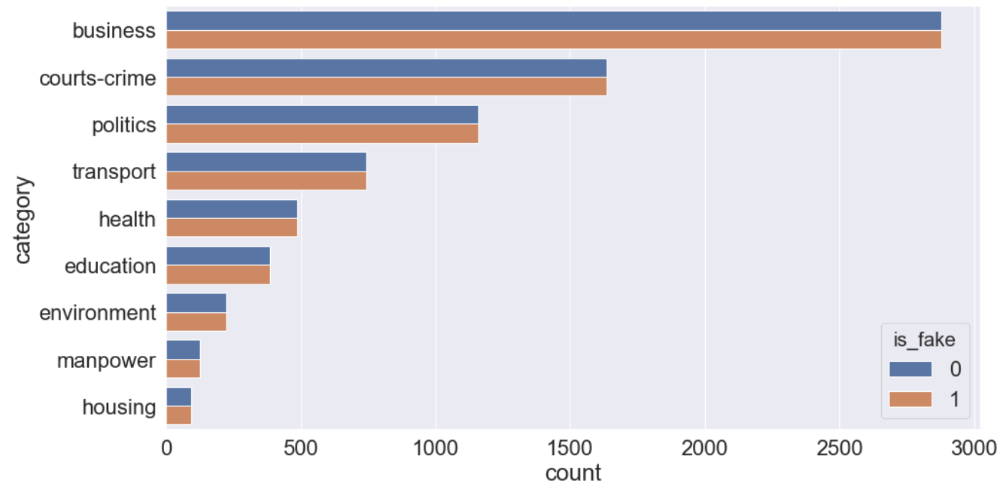
Dataset
Apr 18
May 19
Notes:
The news collected were recently news, taken from Apr 2018 to May 2019.
The categories of the news are shown in this chart, and majority of them are related to business.

Slide 27
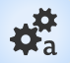
Approach with Machine Learning Models
Step 1
Web Scrapping
The Straits Times
TodayOnline
Step 2
Generate Fake News with GPT-2 Model
Text Preprocessing
Remove Stopword
Lowercase
Min/ Max Count
Step 3
Step 4
Count-based Word Embedding
CountVectorizer
Term Frequency-Inverse Document Frequency (tf-idf)
ML Models (train, test)
Logistic Regression
Linear SVM
Naïve Bayes
Random Forest
XGBoost
Step 5
Notes:
So my first approach to this project is to start with the classical Machine Learning Classfication Models.
Read from screen.

Slide 28
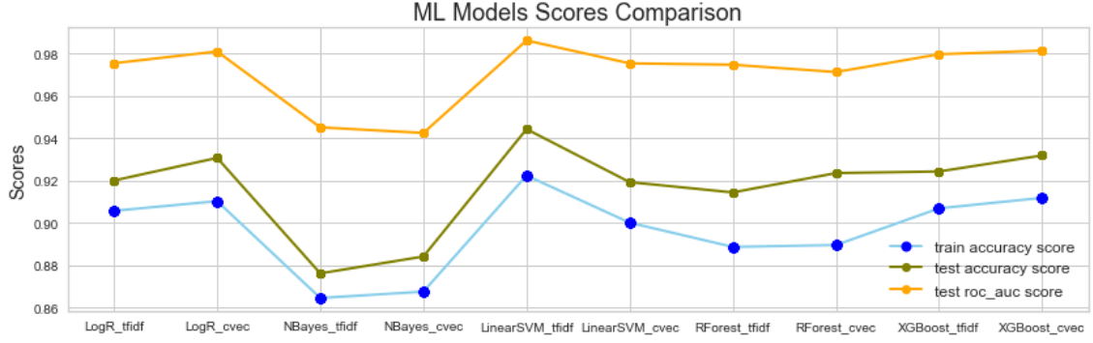
Model Scores Comparison
On Training and Test Datasets
Notes:
There are 5 different models, and each model has two variants. For example there is a LogReg model with tf-idf inputs and LogReg model with countvectorize inputs. There is also a Naïve Bayes model with tf-idf inputs and countvectorize inputs.

Slide 29
Model Scores Comparison
On Training and Test Datasets
Train set: 2/3 data
Test set: 1/3 data
Train Accuracy Score
0.92
Test Accuracy Score
0.94
ROC_AUC Score
0.99
Notes:
The dataset is split into train and test sets, with train set have 2/3 of the data and test set having 1/3 of the data. The model is solely trained with train dataset and tested on the unseen test dataset.
These are scores for the trained sets. To my surprised, all models performed generally quite well with scores above 0.85.
The Linear Support Vector Machine model with tf-idf inputs has the highest train score of 0.92.
The green line is the test scores on unseen data, and generally also performed quite well and close to train scores.

Slide 30
Predictions
1
"North korea is testing out missiles on americans living overseas.“
Probability that is FAKE: 76%
2
"The chemicals in the water is turning the freaking frogs gay.“
Probability that is FAKE: 52%
3
"Lee Hsien Loong is the greatest Prime Minister of all time period.“
Probability that is FAKE: 99%
Notes:
Let’s test out the predictions on some of the sentences.

Slide 31
A “News” Approach
Pre- trained Word Embedding (GloVe)
LSTM Model
Able to capture the semantic relationships of words
Lee Hsien Loong ---- (related) ---- Prime Minister
Lee Hsien Loong ---------- (maybe related) ---------- Best Prime Minister
Lee Hsien Loong -------------------------- (not related) --------------------------- Pokemon Master
Able to retain information on the order sequence of texts

Slide 32
Global Vector (GloVe)
Unsupervised Learning Model for Word Embedding
To represent Words with Numerical Maxtrix Vectors
Open-source project by Stanford University
6 billion Tokens with 400k Vocabulary Words
Transfer Learning
Transfer the established vectorised learned for 2.5M of words in my dataset
Only need to learn the remaining 200k words not listed in GloVe

Slide 33
A “News” Approach
Word Embedding + LSTM Model (Neural Network)
Layer 1
Word Embedding
Transfer Learning of
pre-trained vectors from GloVe
Layer 2
Layer 3
Notes:
Hence this prompted me to try out a new approach, or a ‘news’ approach, which is to use word embedding (in particular word vectorization) and a neural network model called long short-term memory, in short LSTM.
The first layer of my neural network is the word embedding layer which consists of the transfer learning of pre-train vectors from GloVe.

Slide 34
Global Vector (GloVe)
Open-source project by Stanford University
Unsupervised Learning Model for Word Embedding
Transform Words into Numerical Matrix Vectors
in order to capture the semantic associations between each word
Pokemon Master
6 billion words
Lee Hsien
Loong
Prime Minster
Notes:
What is GloVe? GloVe stands for Global Vector, and is an open source project started by Stanford University. It is an unsupervised learning model for word embedding. What it does is to transform words into numerical matrix vectors in order to capture the semantic associations between each word.
For example, imagine each word represents a vector point in a 3d vector space or X amount of dimension. In this case we are looking at 3d. The word Lee Hsien Loong may have a stronger association with Prime Minister than Pokemon Master, thus a short distance between them.
This GloVe model has been trained on many corpuses with a total of 6 billions words

Slide 35
A “News” Approach
Word Embedding + LSTM Model (Neural Network)
Layer 1
Word Vectorisation
Transfer Learning of Pre-trained vectors from GloVe
To capture semantic associations
Layer 2
Long short-term memory (LSTM)
predict next word
based on previous few words
Layer 3
Dense
sigmoid activation
to output 0, 1
Notes:
So for my first layer, im using the pre-trained vectors from GloVe to capture the semantic association of the words in my articles.
The second layer is the normal LSTM that helps to predict the next word based on the previous order sequence of texts
The last layer is a normal output dense layer with sigmoid activation that transform the final output to be either 0 or 1.

Slide 36
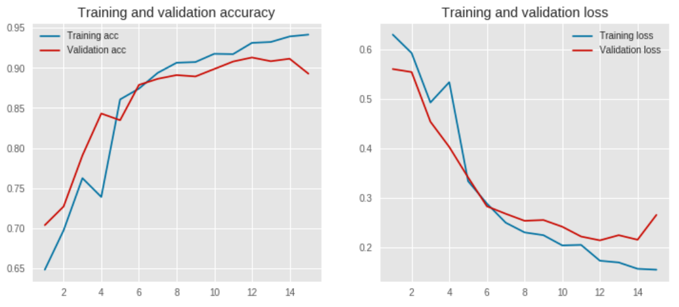
Accuracy and Loss Across Each Epoch
Train set: 2/3 data
Validate/ Test set: 1/3 data
Batch Size: 128
Epochs: 15
Score
Loss
Epoch
Epoch

Slide 37
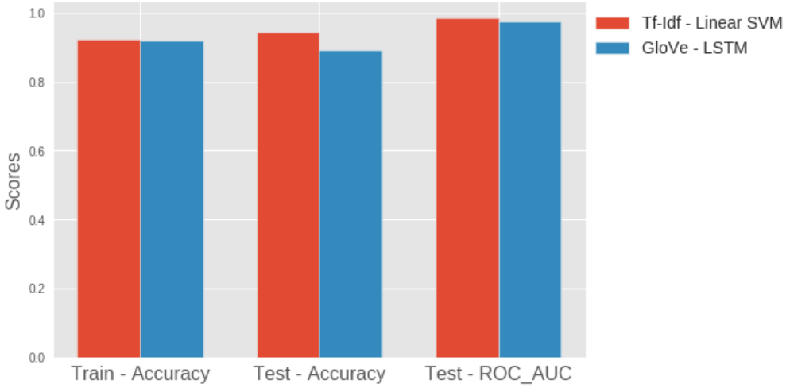
Linear SVM (Machine Learning) vs
LSTM (Neural Network)
0.99
0.97
0.92
0.92
0.94
0.89
Train: 2/3 data
Test: 1/3 data
Notes:
Lets see how the neural network perform against the previous linear SVM model.
The accuracy scores on both train and test sets are very comparable, likewise the same for the ROC_AUC score on the test set.

Slide 38
Predictions
1
"North korea is testing out missiles on americans living overseas.“
Probability that is FAKE: 0.44
2
"The chemicals in the water is turning the freaking frogs gay.“
Probability that is FAKE: 0.80
3
"Lee Hsien Loong is the greatest Prime Minister of all time period.“
Probability that is FAKE: 0.94

Slide 39
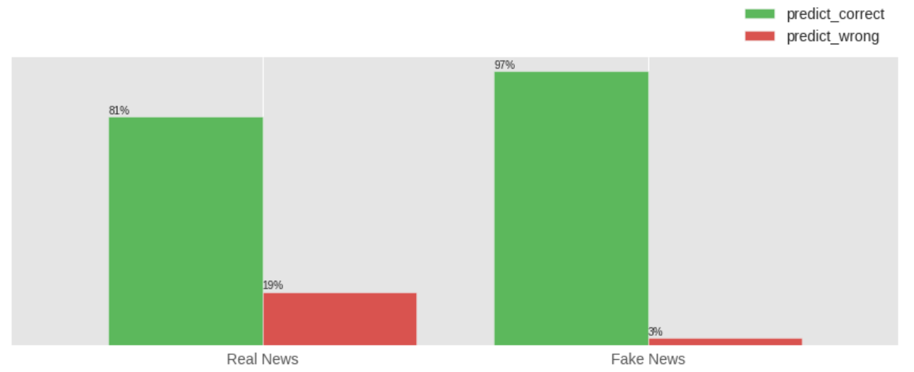
LSTM Misclassification Rate on Test Dataset (5k articles)
97% (2498 articles)
81% (2085 articles)
2575 articles
2575 articles
Actual Class
Notes:
This chart shows the misclassification rate of LSTM on the test dataset.
There is a total of 2575 real news article and 2575 of fake news articles for my test dataset. For the real articles the LSTM model manage to predict 81% correctly as real. And for the fake articles, the model managed to predict 97% correctly as fake.
This ratio is good as the consequence of predicting a fake article to real is worse than predicting a real article to be fake.
The threshold of the model can be tweaked to further reduce this 3%, at the compromised of increasing this 19%.

Slide 40
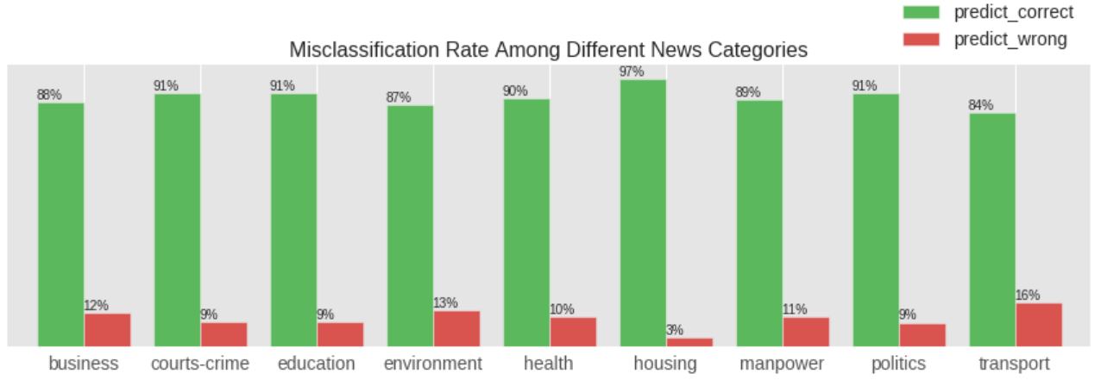
Misclassification Rate of each
News Categories on Test Dataset
Notes:
This is my last chart. In general the prediction accuracy for each category are below 15%, even though the number of business articles we have are much more than the rest. We do not see a particular genre suffer cos the number train dataset is very little.

